Slide 1
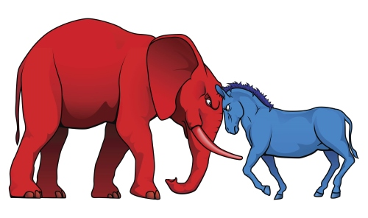
US Political Polarity
FINAL REPORT
AJ Marcus

Slide 2
Politics has become a large societal concern in the United States and the polarizing stances on common issues has given way to social unrest, tension, and distrust.
The goals validated the existence, primary actors, and timeline of political polarity as a baseline for future analysis.
Modeling for voting predictions yielded reasonable success but lacks refinement without additional data sources and lagging indicators
FINAL REPORT

Slide 3
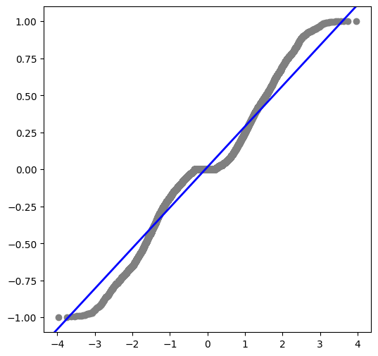
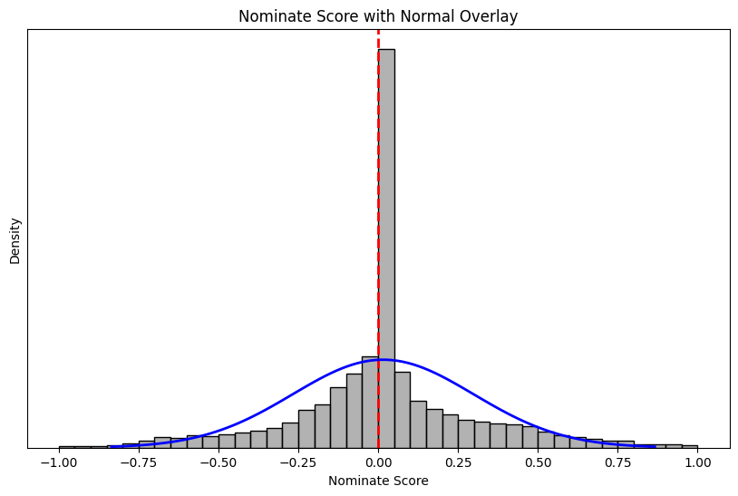
Report Outcomes
Preprocessing
Trending Model
Findings
Prediction Model
Preprocessing
Congressional voting records were non-normal from holistic data
Strata on Congressional Bodies, Sessions, and inter-Sessions showed consistently non-normal distributions

Slide 4
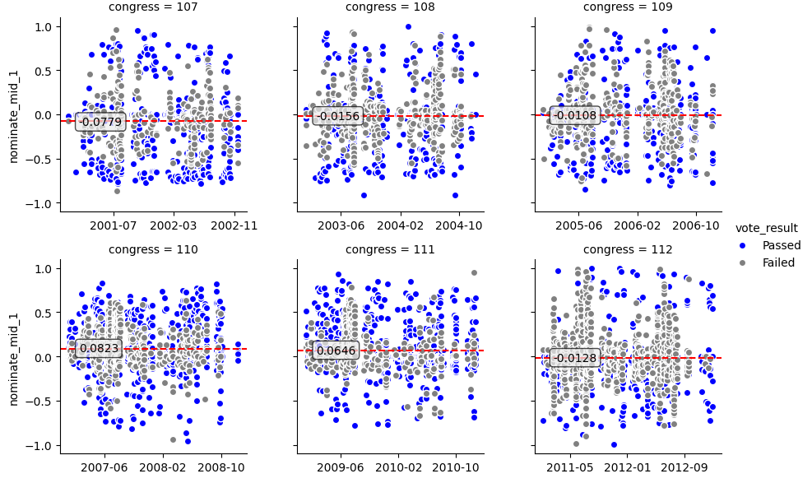
Report Outcomes
Preprocessing
Trending Model
Findings
Prediction Model
Preprocessing
Voting outcomes were sufficiently random across multiple strata, supporting data independence

Slide 5
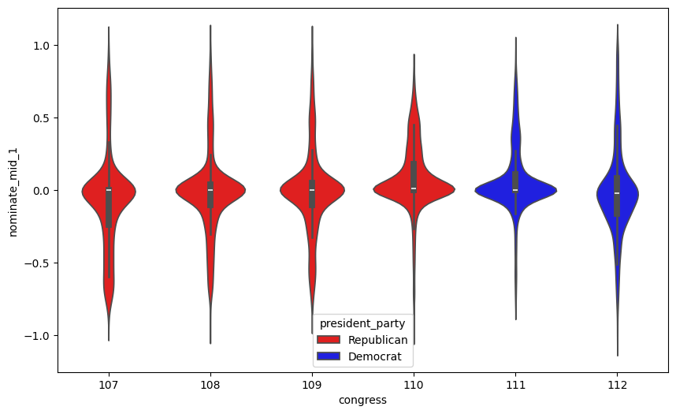
Report Outcomes
Preprocessing
Trending Model
Findings
Prediction Model
Preprocessing
Voting outcomes showed inconsistent variance across Sessions, supporting independence between each Congress
Notes:
By using the Fligner-Killeen test of group population variances, we can show the only similarity each Congress shows appears to be during continued Presidential terms where the incumbent

Slide 6
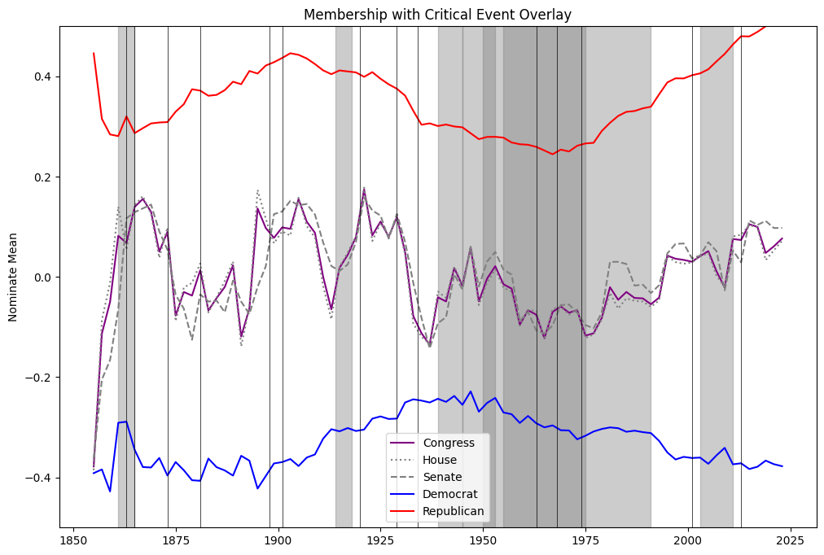
Report Outcomes
Preprocessing
Trending Model
Findings
Prediction Model
Trending Model
Time-series analysis confirmed 1970s as point of polarization noting the overlay of multiple global and sovereign events

Slide 7
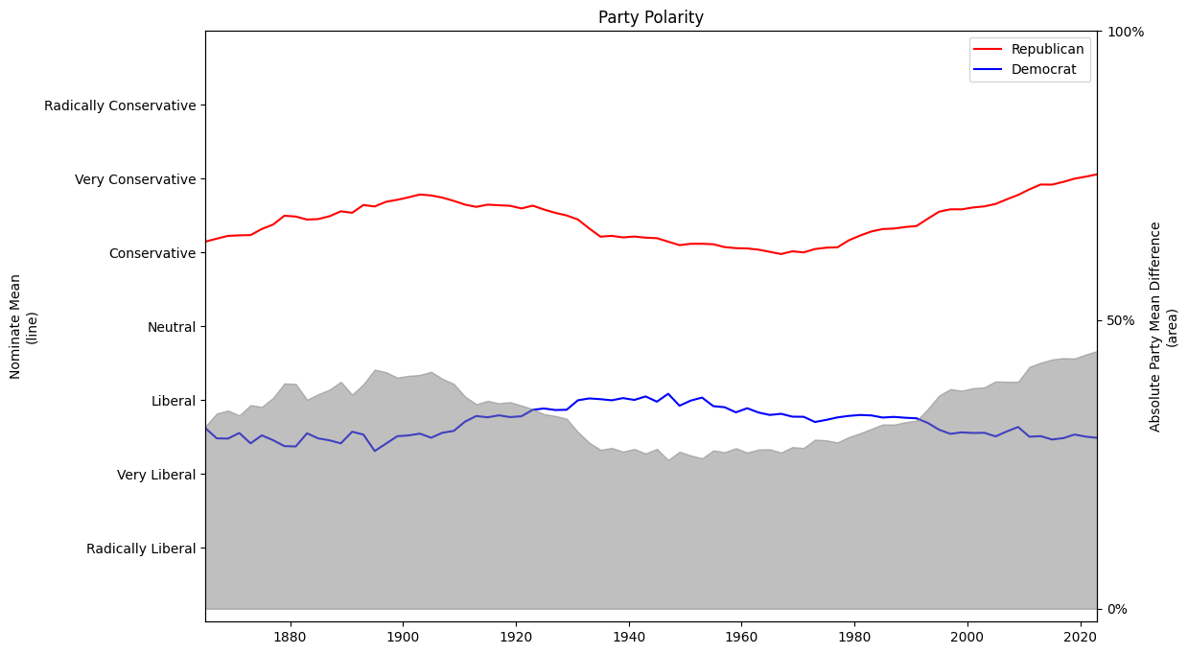
Report Outcomes
Preprocessing
Trending Model
Findings
Prediction Model
Findings
Polarization notably deviated in 1970s
Polarization is driven from radicalization of the right

Slide 8
Report Outcomes
Preprocessing
Trending Model
Findings
Prediction Model
Findings
Congressional Sessions are resultingly independent from each other
Congress has negligible ability to “undo” or counterpose prior Congress Sessions’ legislative actions; fastest movements were noticeable after 3 sessions (6 years)

Slide 9
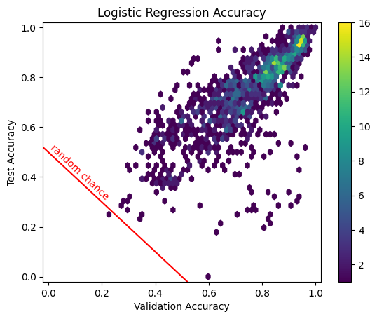
Report Outcomes
Preprocessing
Trending Model
Findings
Prediction Model
Prediction Model
Member votes were predicted via Logistic Regression and Random Forest models

Slide 10
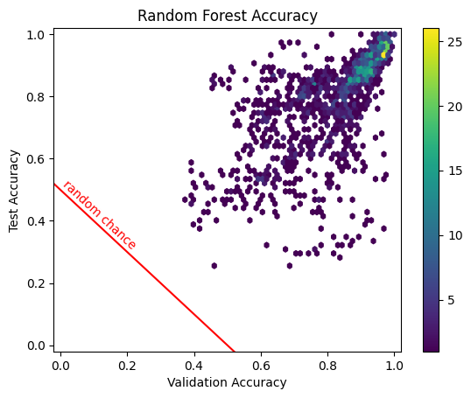
Report Outcomes
Preprocessing
Trending Model
Findings
Prediction Model
Prediction Model
Logistic Regression showed lower variance but also lower predictive power

Slide 11
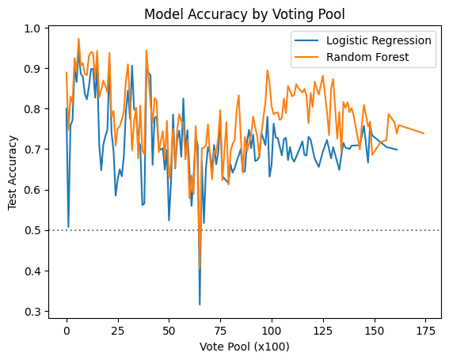
Report Outcomes
Preprocessing
Trending Model
Findings
Prediction Model
Prediction Model
Overall predictive powers ranged from 60% - 95% accuracy
Model accuracy did not stabilize with larger voting pools, suggesting change of political position over time

